Slide 1
AngularJS
AngularJS
Lecture 5
By James(Jin) Wang
08/01/2019

Slide 2
Outline
Factory and Service Overview
Creating a Factory
Creating a Service
Defining Application Values
Making Ajax Calls from a Factory/Service

Slide 3
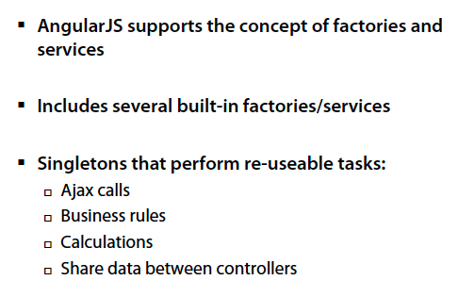
Factories and Services
  Factories and Services:

Slide 4
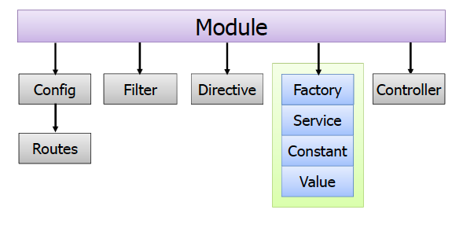
Factories and Services
  Creating Factoreis, Services and More:

Slide 5
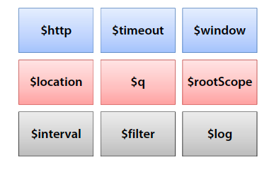
Factories and Services
  Built-in AngularJS Services:
  AngularJS provides many built-in services:

Slide 6
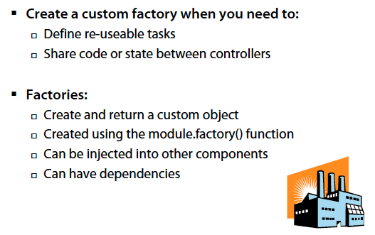
Factories and Services
  What is a Factory?

Slide 7
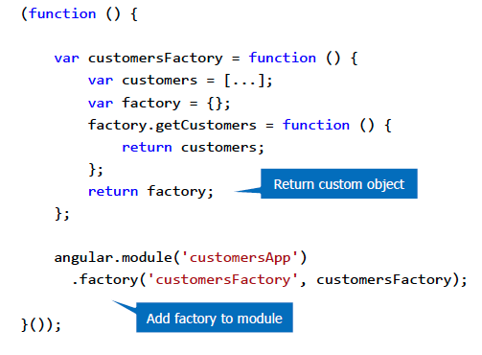
Factories and Services
  Creating a Factory:

Slide 8
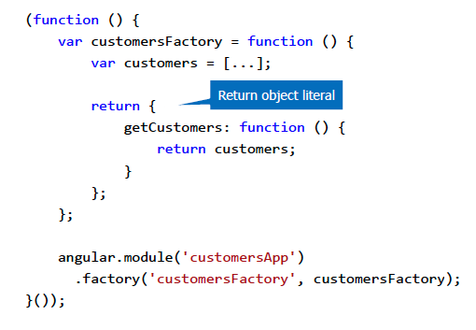
Factories and Services
  Alternate Syntax:

Slide 9
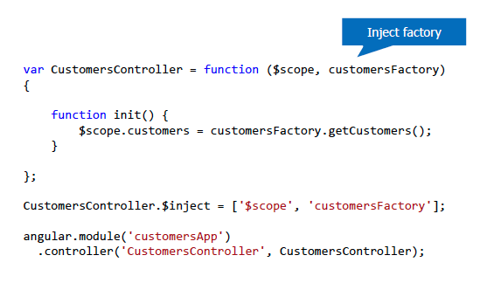
Factories and Services
  Injecting a Factory:

Slide 10
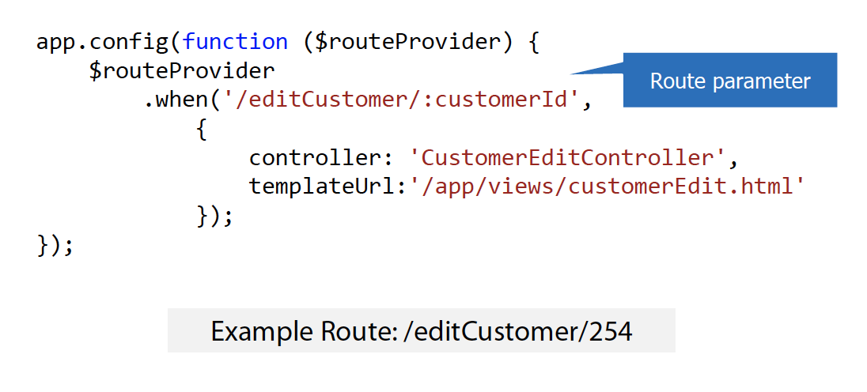
Factories and Services
  Route parameters can be defined using the : character

Slide 11
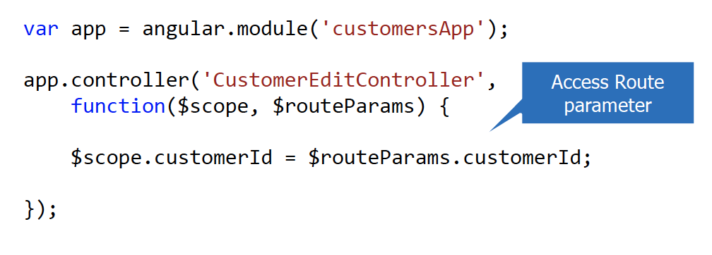
Factories and Services
  Route parameters can be accessed through the $routeParams provider

Slide 12
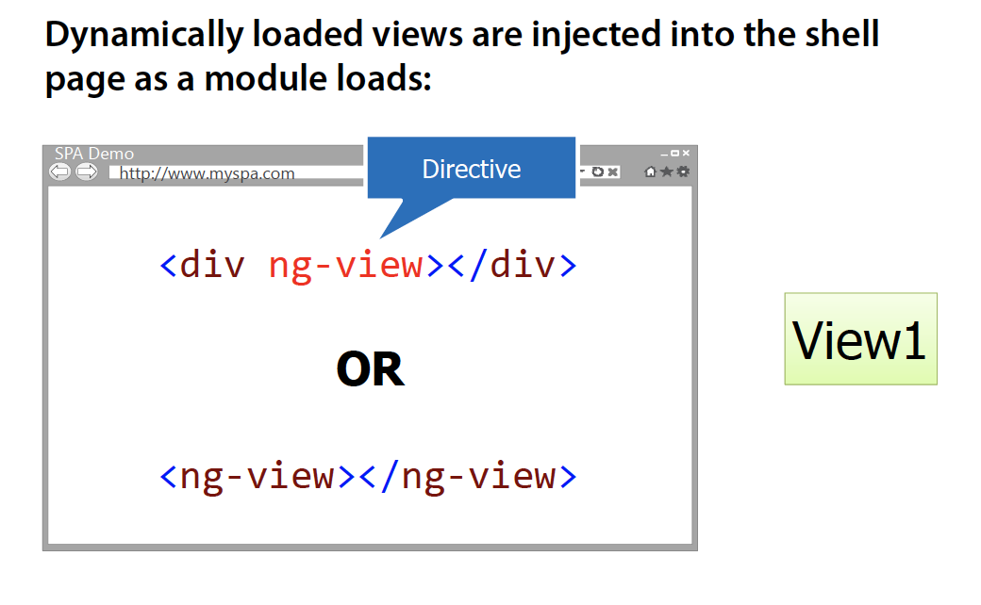
Factories and Services
  Using the ng-view Directive:

Slide 13
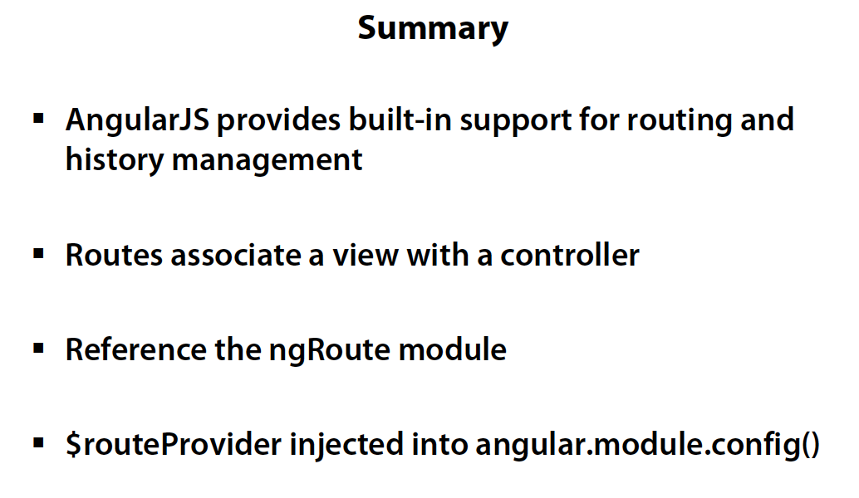
Routing

